Slide 1
Implementing and Evaluating MPTCP on the SCION Future Internet Architecture
Presentation master thesis
Michael A. Flückiger
August 28, 2020
Notes:
Welcome again
Happy that I today can present the work I did during my master thesis.

Slide 2
Projektanalyse – Folie 2
On the menu
Introduction
Functionality of Shila
Performance evaluation
Future work
Notes:
Let us start with an overview what I‘m going to cover in the next 30 minutes:
Start with the Introduction: What are the ingredients of my work?
What was the goal?
And why do we want to reach that goal?
After the Introduction you all will known Shila. So I Then will explain her functionality based on an example.
I will say some words about the performance evaluation I did and conclude the presentation with some references to future work.

Slide 3
Projektanalyse – Folie 2
On the menu
Introduction
Functionality of Shila
Performance evaluation
Future work
Notes:
So let’s start with the Introduction...

Slide 4
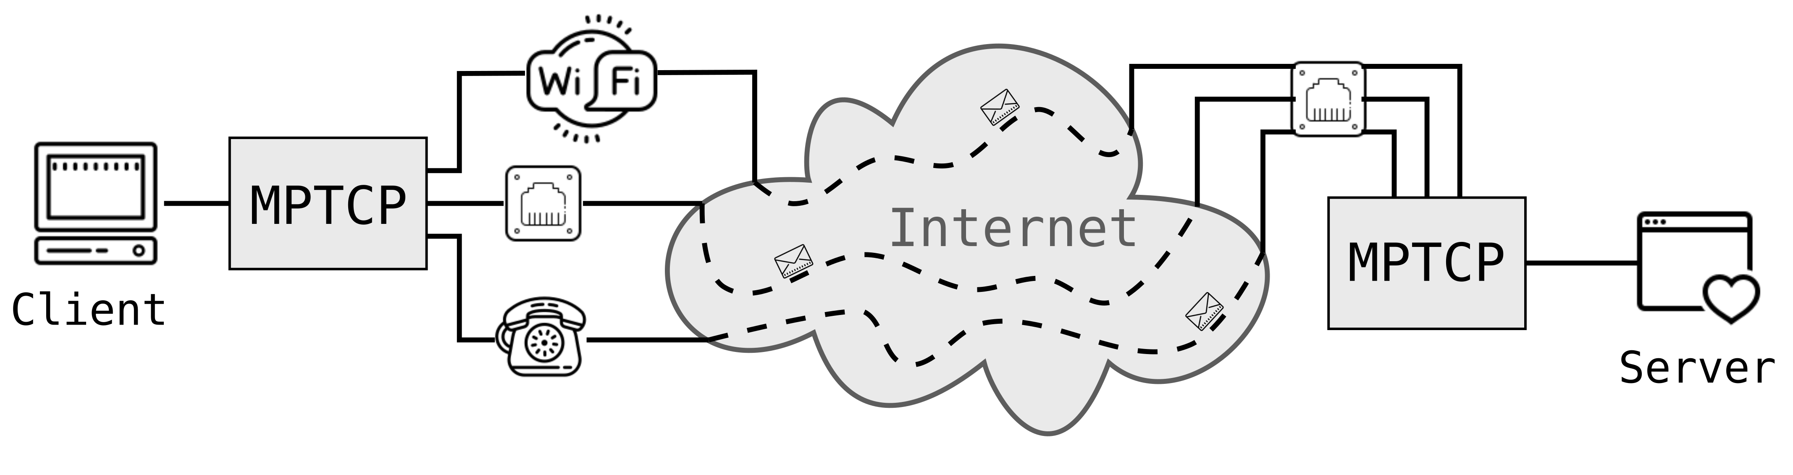
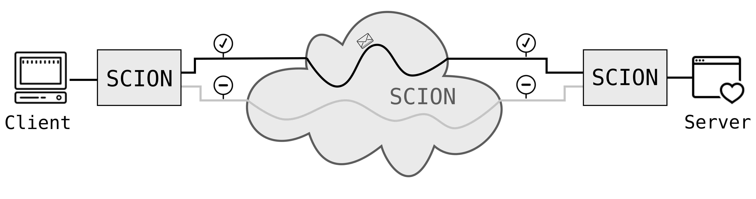
Projektanalyse – Folie 2
Introduction
Ingredients?
TCP (Transmission Control Protocol)
Dominant transport protocol in today’s Internet
One path per connection
MPTCP (Multipath TCP)
Extension to TCP
Multiple paths (flows) per connection
SCION (Scalability, Control and Isolation on next-generation networks)
More secure network architecture
Implements path transparency
Support for multiple paths
Notes:
As the title suggests, the work has two main ingredients, MPTCP and SCION.
On the one hand MPTCP, an extension to TCP.
TCP protocol that is used a lot
Supports one path per connection
MPTCP supports multiple paths (or flows) for a single connection.
Every available network interface is used (figure)
TCP and MPTCP: No path transparency (figure: indicated through dashed line), sender and receiver
have no idea about path their data takes
SCION: Successor of today’s Internet (hopefully ☺)
Two points important to mention here:
It implements path transparency
Provides inherently support for multiple paths

Slide 5
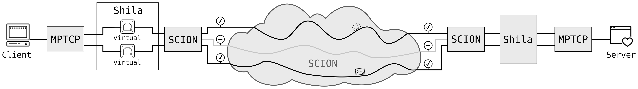
Projektanalyse – Folie 2
Introduction
What?
Main objective and contribution of the presented work:
Implementation (and evaluation) of a shim layer that
allows the usage of MPTCP over SCION.
Notes:
Knowning about our main ingredients, we now can talk about the goal of this work:
So the main objective and cotribution of the presented work was the implementation and the evaluation of a shim
layer that allows the usage of MPTCP over SCION.
I gave the implementation the name Shila, short for shim layer.

Slide 6
Projektanalyse – Folie 2
Introduction
What?
Main objective and contribution of the presented work:
Implementation (and evaluation) of a Shim layer that
allows the usage of MPTCP over SCION.
Notes:
This image here shows why Shila deserves her name. She is placed right in between MPTCP and SCION where she fulfills her mediating role between the two technlogies.
As I said, I will explain the functionalty in more detail soon, but before that I want quickly to talk about why one is even interested in MPTCP over SCION.

Slide 7



Projektanalyse – Folie 2
Introduction
Why?
Facilitates promotion and development of SCION
Straightforward use TCP applications over SCION
Benefit for endpoints with MPTCP support
Increase of redundancy thanks to multiple paths
Potential through mediating role of Shila in between
Shila is aware and under control of paths used through SCION
Notes:
A first reason is simple but not less important.:
MPTCP facilitates the promotion and development of SCION, with Shila one can use its favorite TCP application without having
to change anything at its implementation. This lowers the hurdles to try out SCION..
Another reason is that applications benefit from MPTCP and the inherent support of SCION for multiple paths.
Connection with MPTCP over SCION benefits from multiple paths (redundancy) even if there is just one real interface available
(at least from path redundancy, not from connection redundancy)
And as a last point I want to mention here: There is a lot of potential given through the mediating role of Shila in between. As an example:
MPTCP has a special congestion control which makes sure that the MPTCP connection does not disadvantage other
regular TCP connections in the network. This would be the case if multiple flows of a MPTCP connection share the same link.
Since SCION is implementing path transparency, Shila knows about the paths of the individual flows of a MPTCP
connection and can make sure that all this flows are distinct. Then there is no need to use a conservative congestion control,
Shila can guarantee that the flows share no links.
This as one example of the potential having Shila in this mediating role in between.

Slide 8
Projektanalyse – Folie 2
On the menu
Introduction
Functionality of Shila
Performance evaluation
Future work
Notes:
So, time to discuss the functionality of Shila.

Slide 9

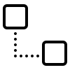
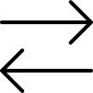
Projektanalyse – Folie 2
Functionality of Shila
Three Parts
Setup
Getting Shila ready to mediate between MPTCP and SCION
Connection establishment
Establish the connection between client and server of a TCP application
Main-Flow and Sub-Flows
Data exchange
Operational mode once connection is up
Notes:
Functionality of Shila can be divided into three parts:
Setup: Shila is getting ready to mediate between MPTCP and SCION
Connection establishment:
Stage where the client of a TCP application reaches out to the server of a TCP application
It consists in the first step of a Main-Flow establishment, so the establishment of the initial connection, and then
one or multiple Sub-Flow establishments.
Once the connection is established, Shila works in “operational mode”, rerouting the data exchanged.
I will now illustrate this three parts based on a running example..

Slide 10
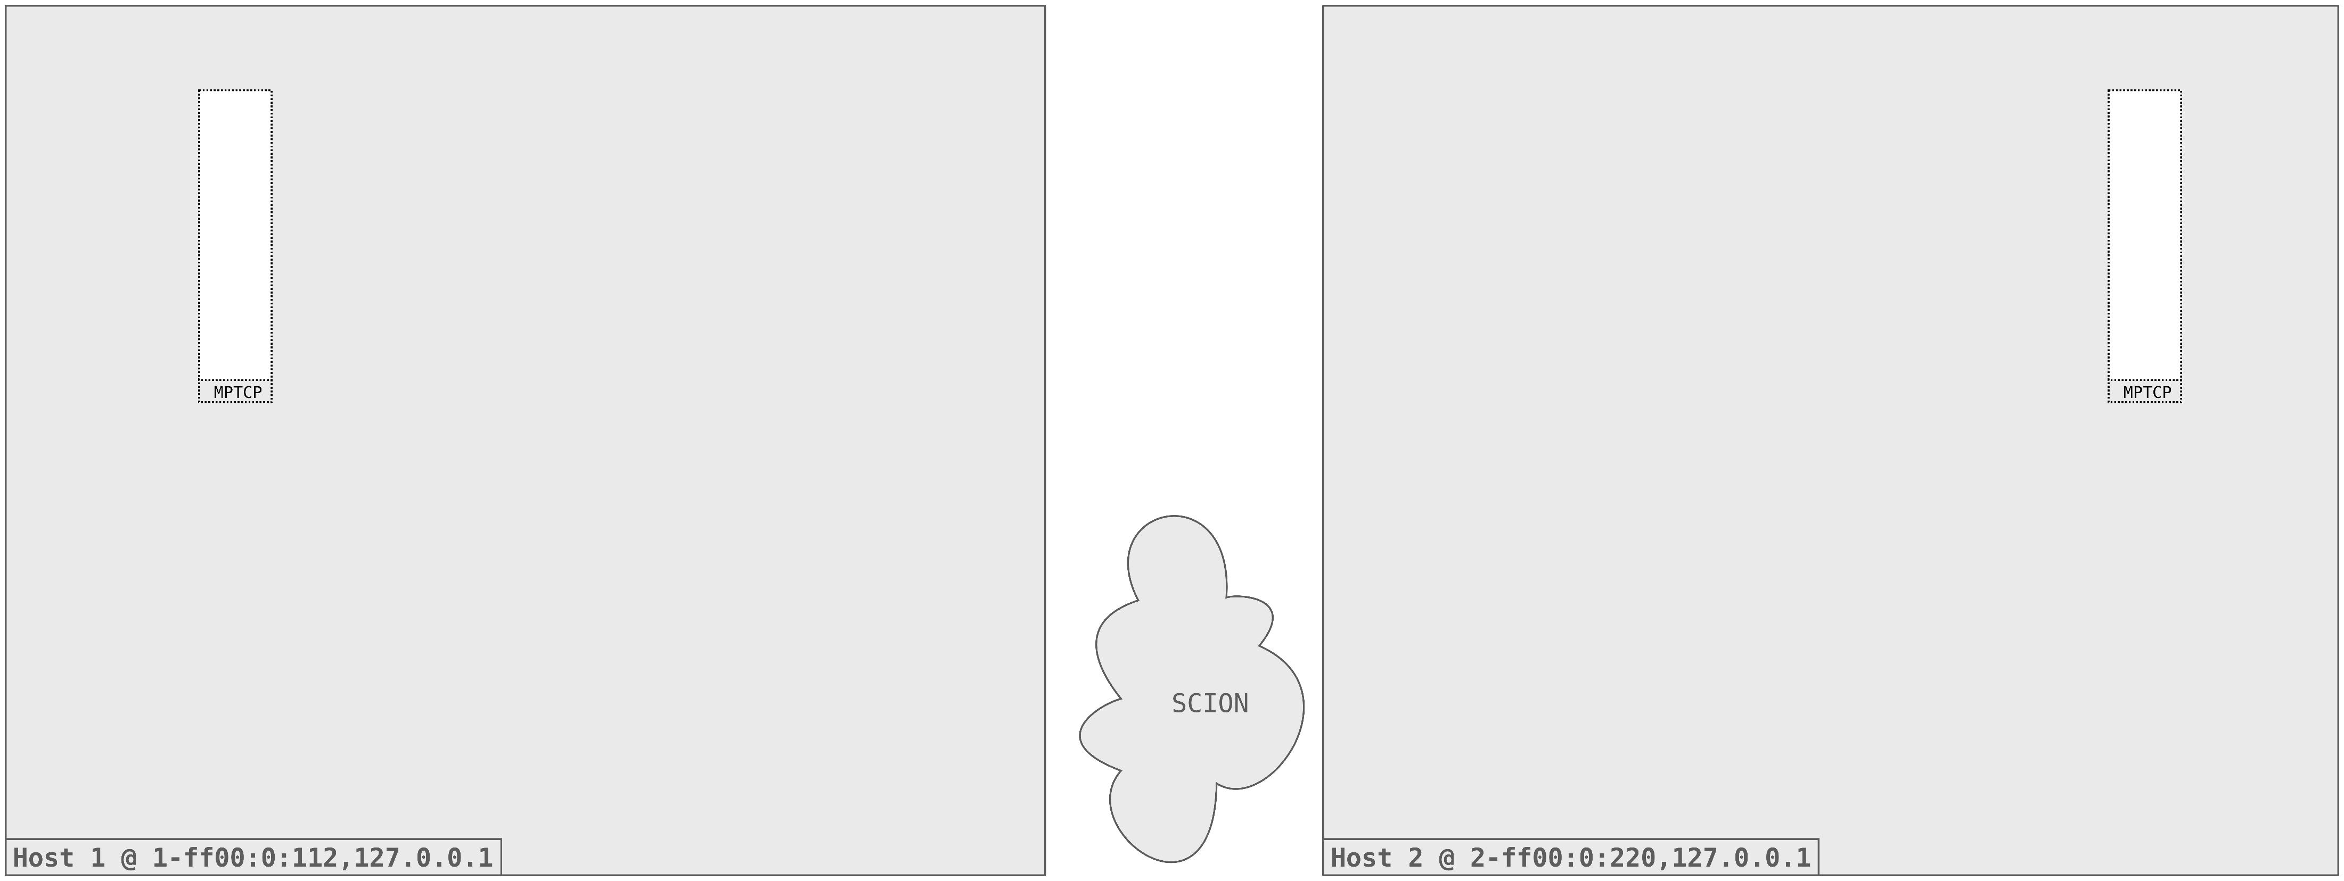
Projektanalyse – Folie 2
Functionality of Shila
Initial situation
Notes:
What we have here is the initial situation:
Two Hosts, Host 1 and Host 2
Connected to the SCION network
Both with support for MPTCP
The example we want to cover is a TCP Client on Host 1 connecting to a TCP Server on Host 2.

Slide 11
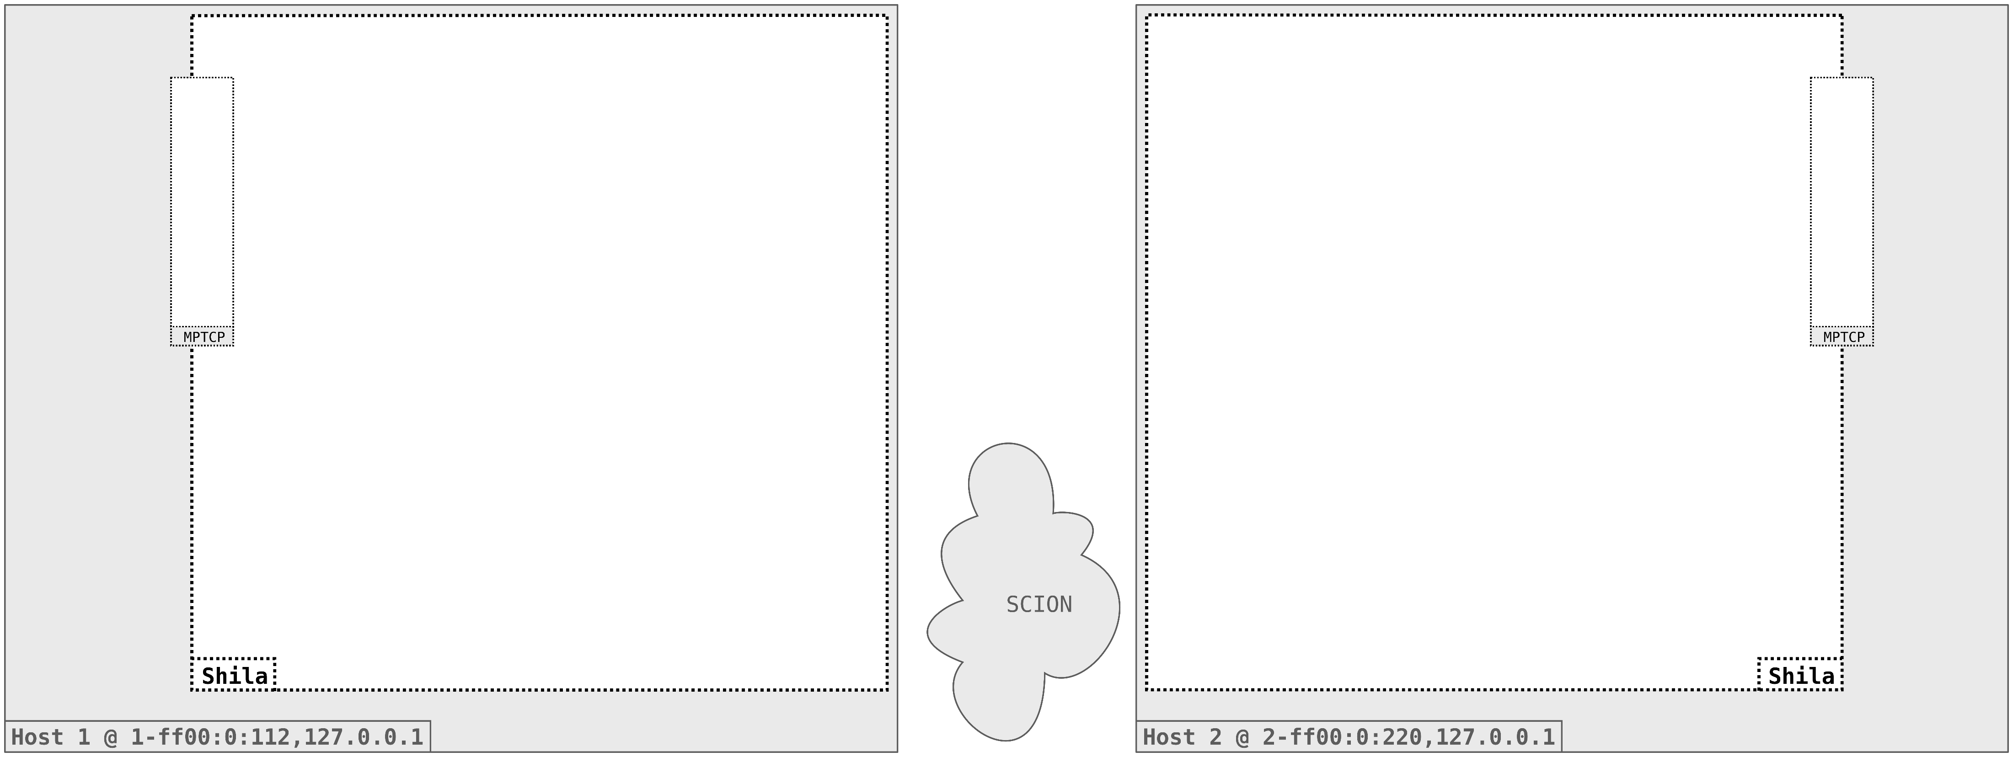
Projektanalyse – Folie 2
Functionality of Shila
Setup
Notes:
Start with the setup (Shila is getting ready to mediate between MPTCP and SCION)
We start Shila on both Hosts. Note that the setup is the same on both, it is sufficient to concentrate
just on the left instance.

Slide 12
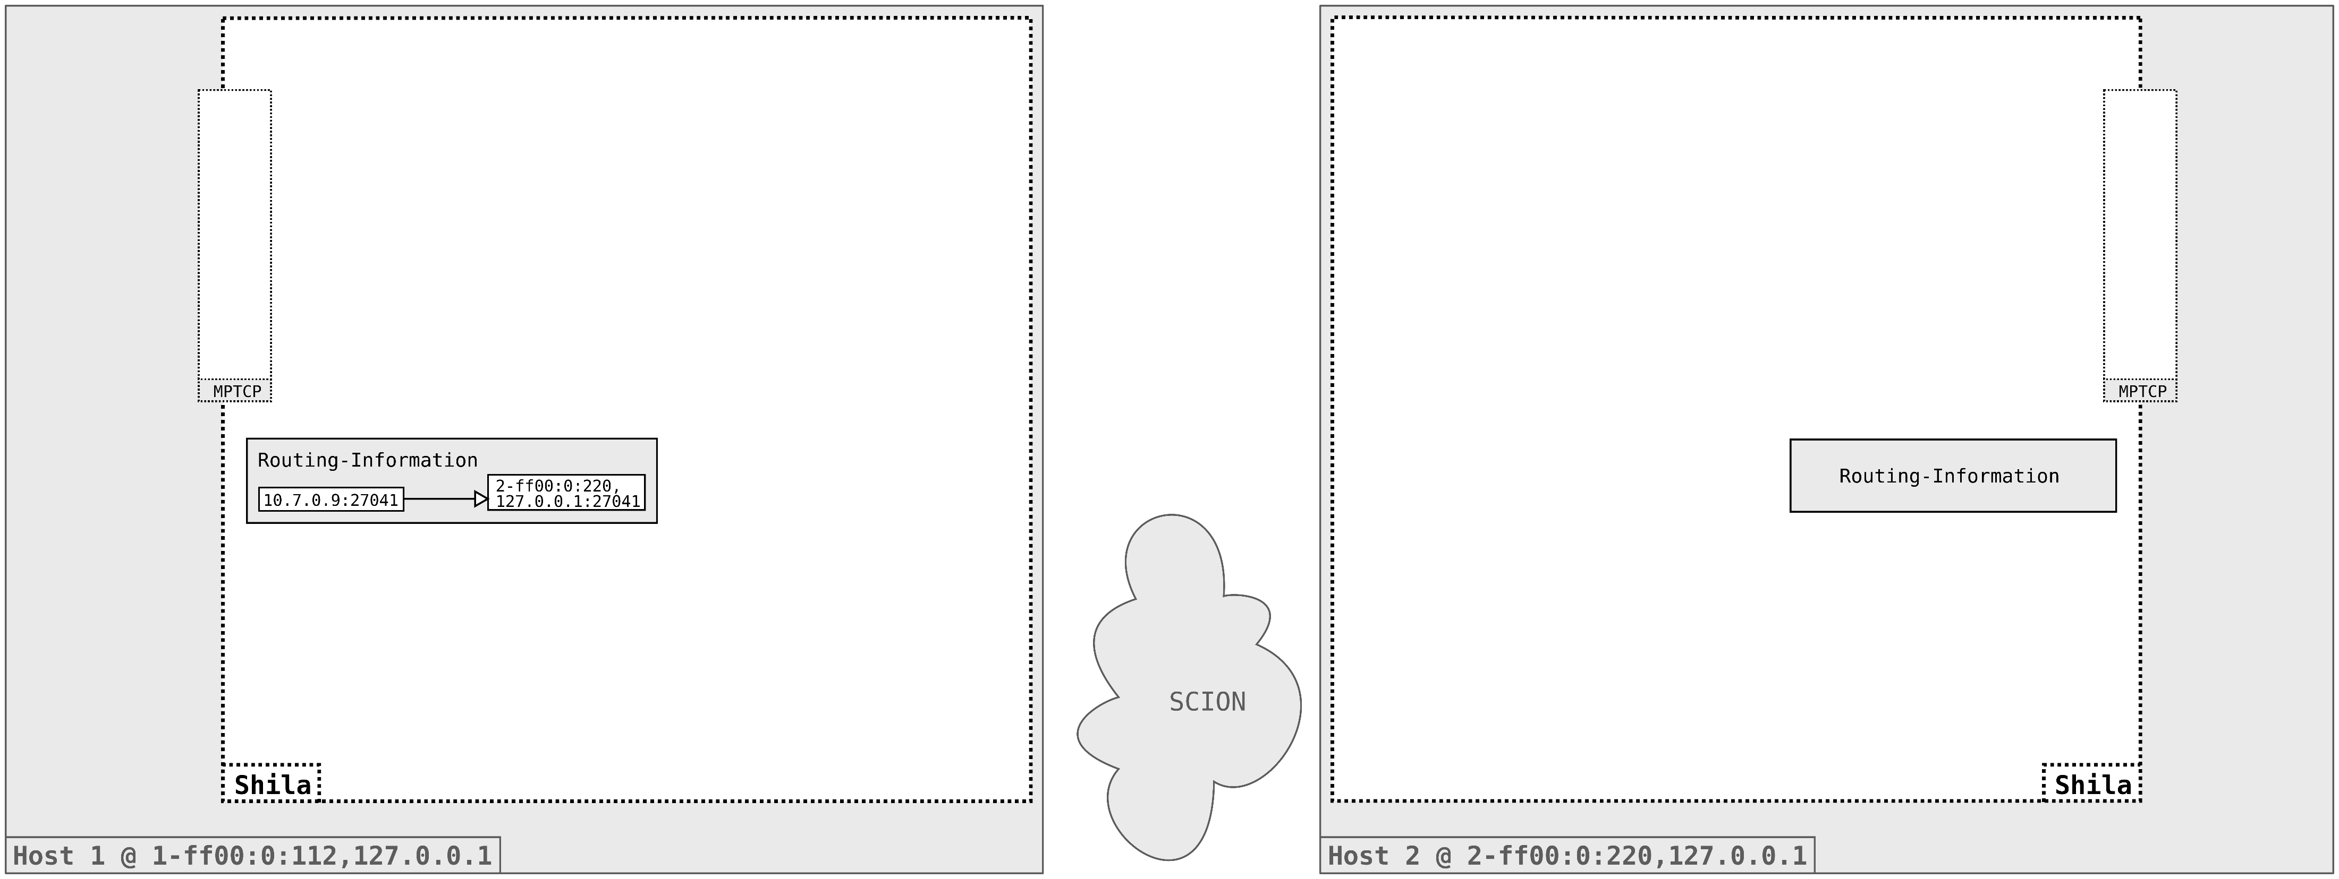
Projektanalyse – Folie 2
Functionality of Shila
Setup
Notes:
Routing Information is loaded
Contains the mapping from TCP destination address to SCION destination address.
We will later see how this is mapping is used and why it is necessary.

Slide 13
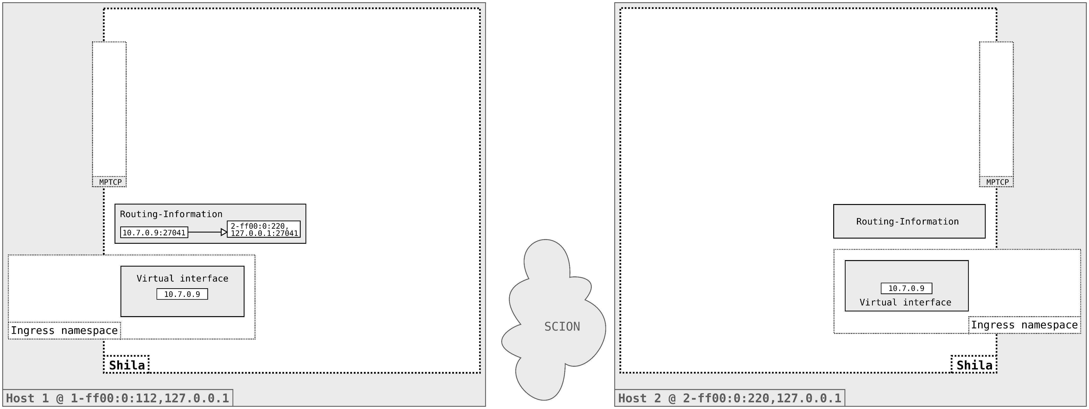
Projektanalyse – Folie 2
Functionality of Shila
Setup
Notes:
Allocation of default ingress namespace
Creation of a single virtual interface with a default IP address.

Slide 14
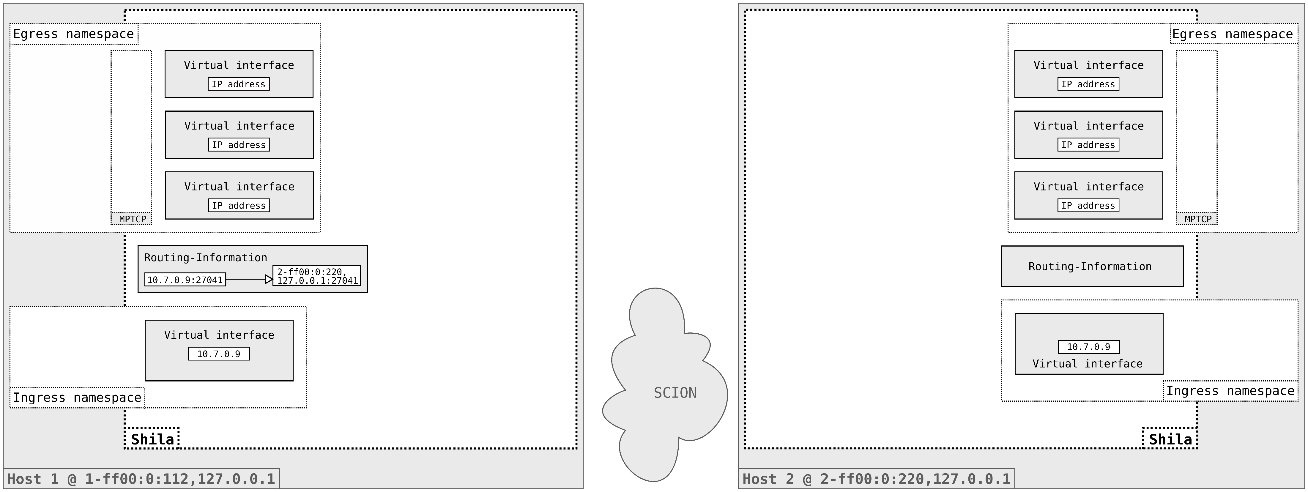
Projektanalyse – Folie 2
Functionality of Shila
Setup
Notes:
Then the egress namespace is allocated
In there, the default number of three virtual interfaces is created. This number can be chosen by the user.
The number of virtual network interfaces created corresponds later to the number of flows used for a single MPTCP connection.
So if for example just one interface is created, then we have just a simple TCP connection.
With three interfaces as we have here, we will have one Main-Flow and two Sub-Flows in the end.

Slide 15

Projektanalyse – Folie 2
Functionality of Shila
Setup
Notes:
As a last step of the setup Shila creates the Contact-Server-Endpoint listening per default on the SCION port 7654.
This endpoint servers, as we will see soon, as an initial point of contact for Shila instances running on different hosts.
This concludes the setup part, Shila is now ready to receive and mediate traffic.

Slide 16
Projektanalyse – Folie 2
Functionality of Shila
Main-Flow Establishment
Notes:
We will now step through the Main-Flow establishment. As I said, this is the establishment of the first of possible
multiple flows of a single MPTCP connection between two endpoints.

Slide 17
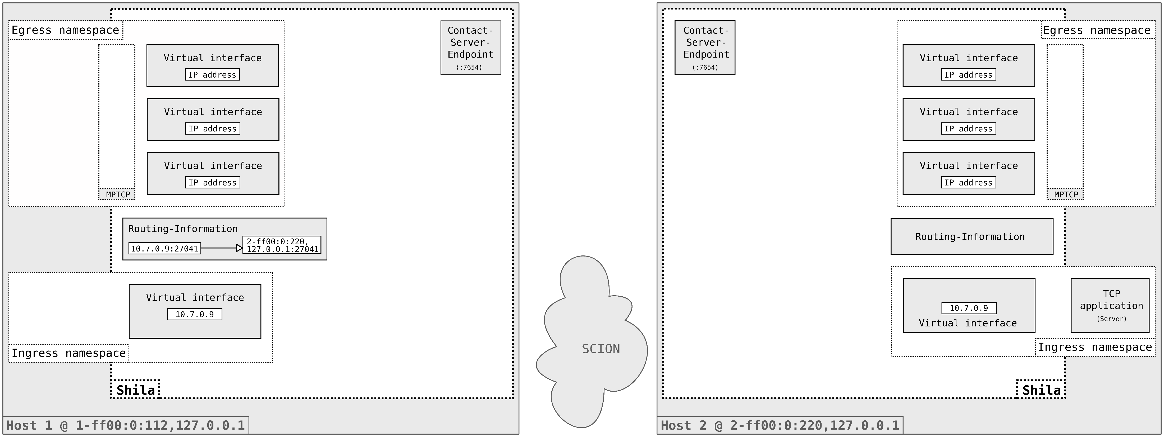
Projektanalyse – Folie 2
Functionality of Shila
Main-Flow Establishment
Notes:
Start of the TCP Server application in the ingress namespace of the Shila instance on Host 2.

Slide 18

Projektanalyse – Folie 2
Functionality of Shila
Main-Flow Establishment

Slide 19
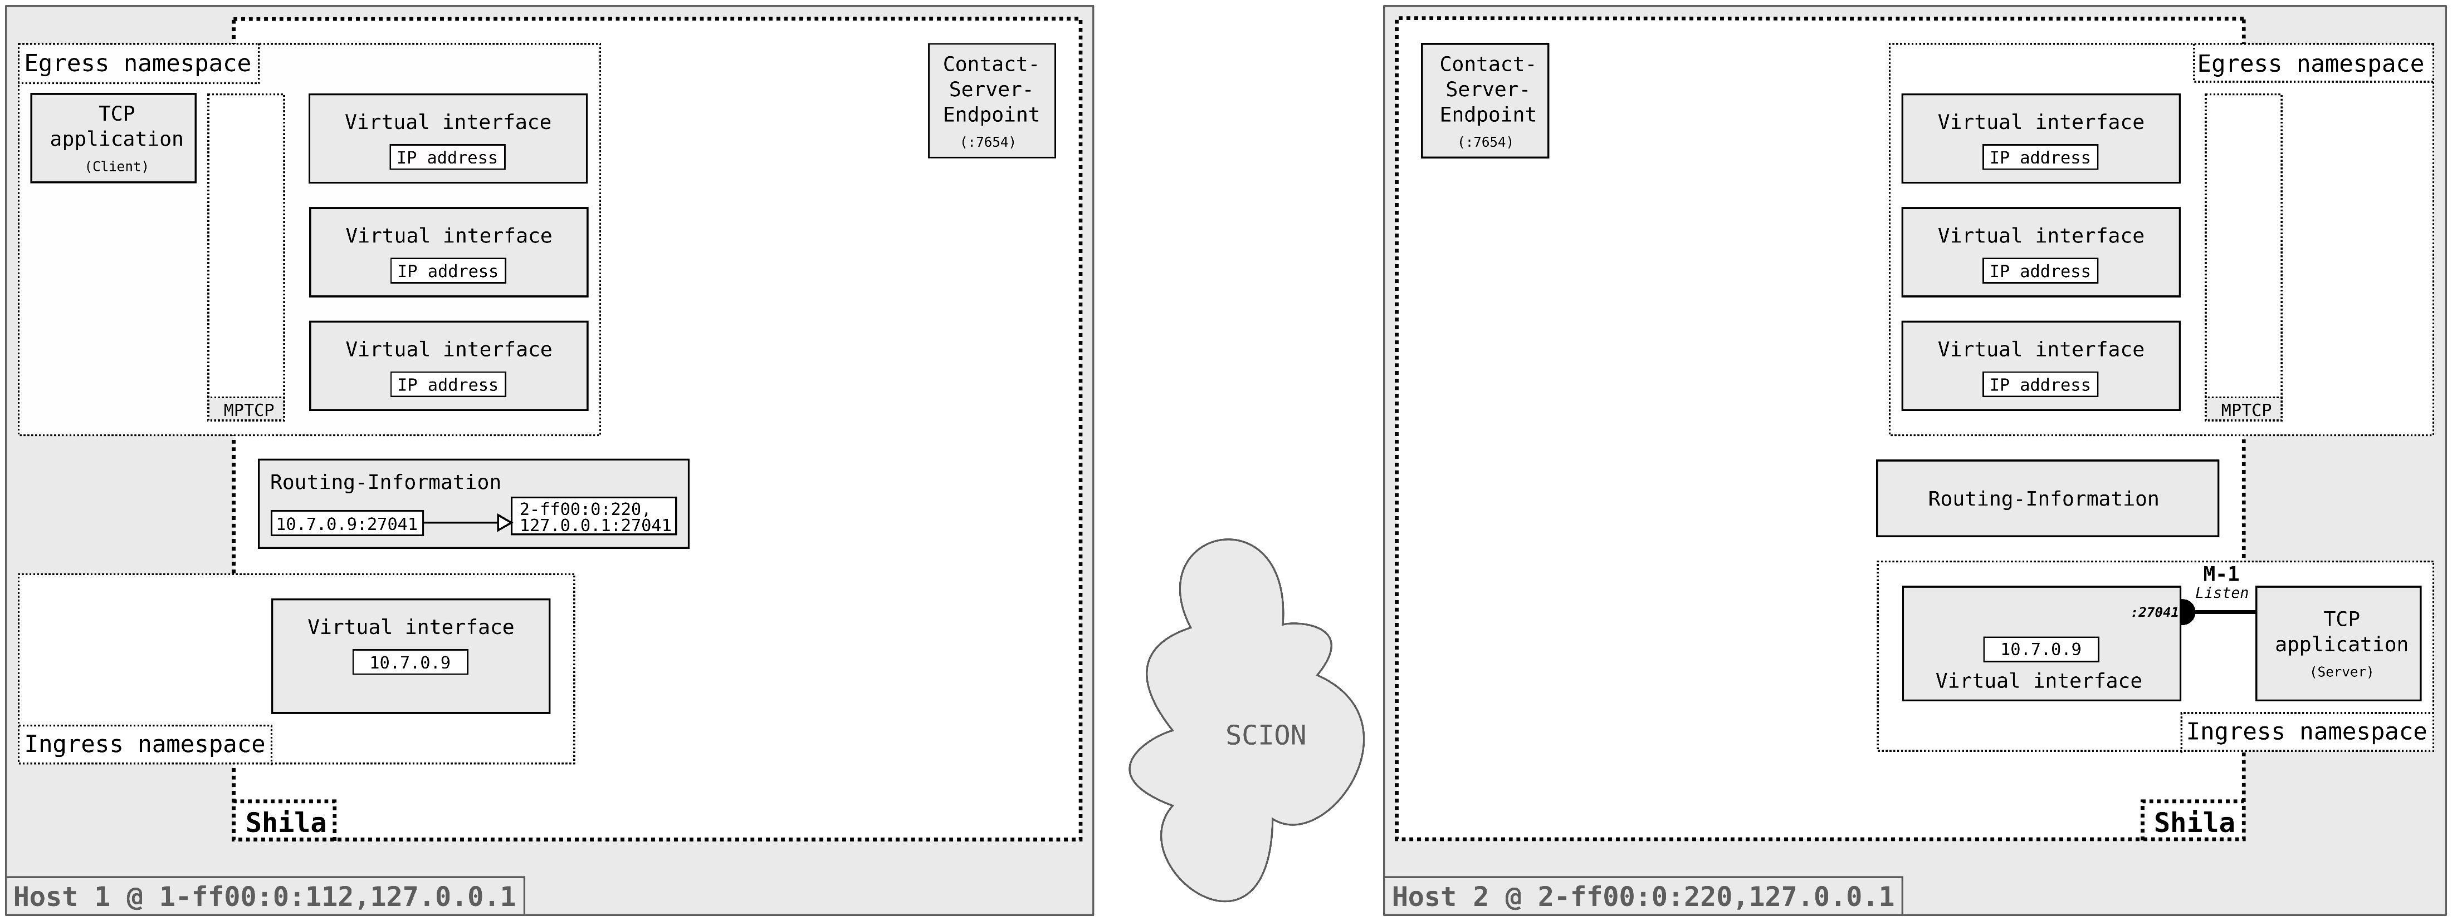
Projektanalyse – Folie 2
Functionality of Shila
Main-Flow Establishment

Slide 20

Projektanalyse – Folie 2
Functionality of Shila
Main-Flow Establishment

Slide 21
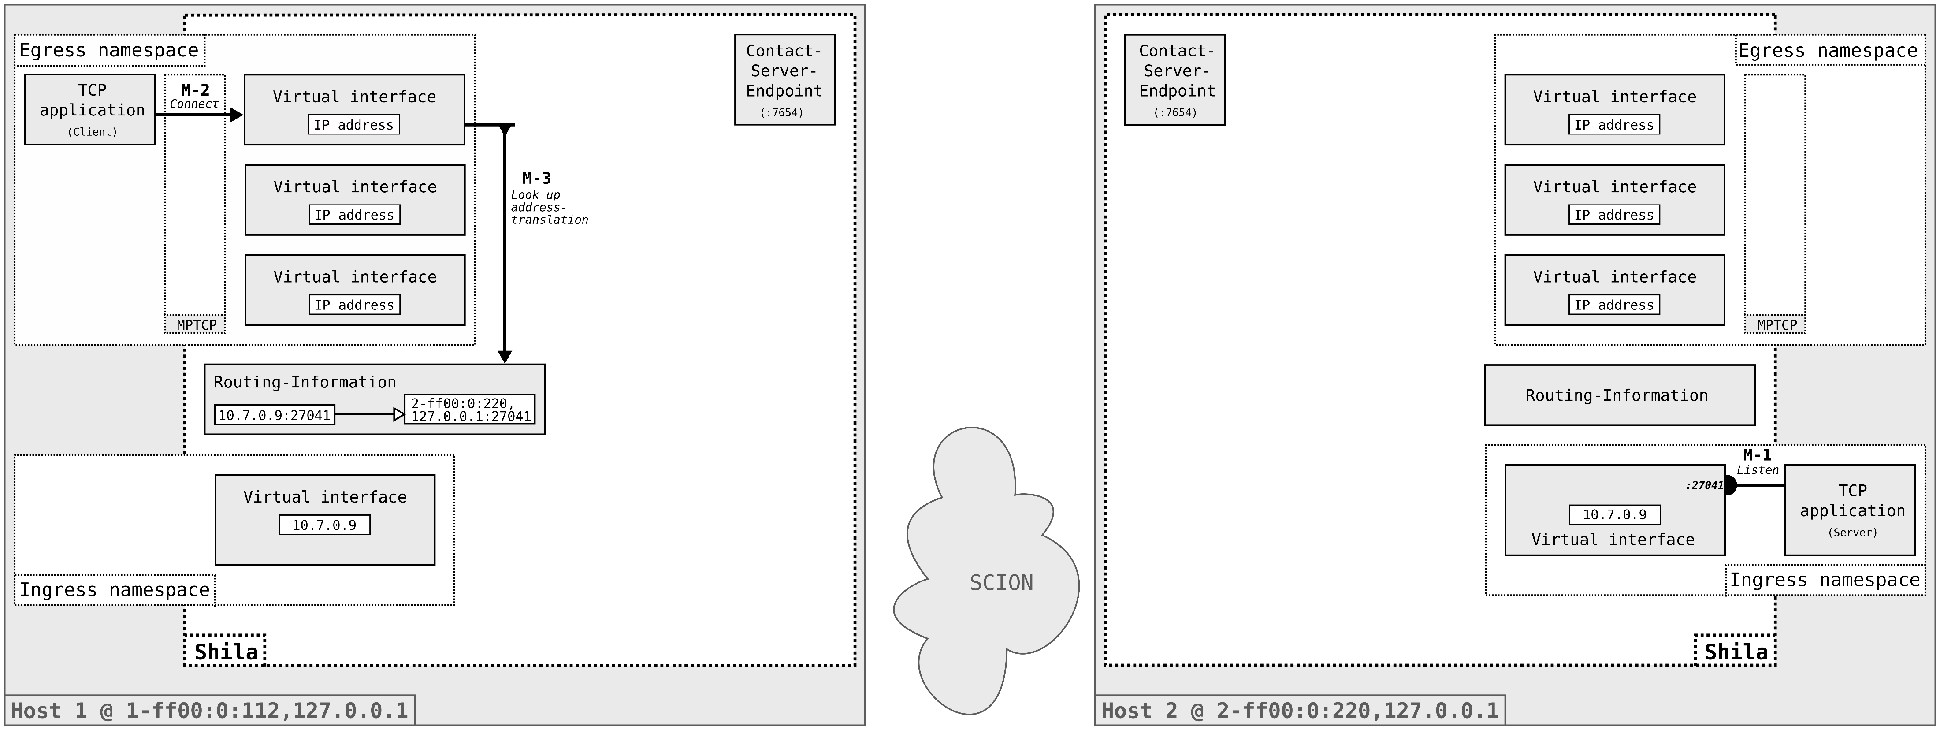
Projektanalyse – Folie 2
Functionality of Shila
Main-Flow Establishment

Slide 22
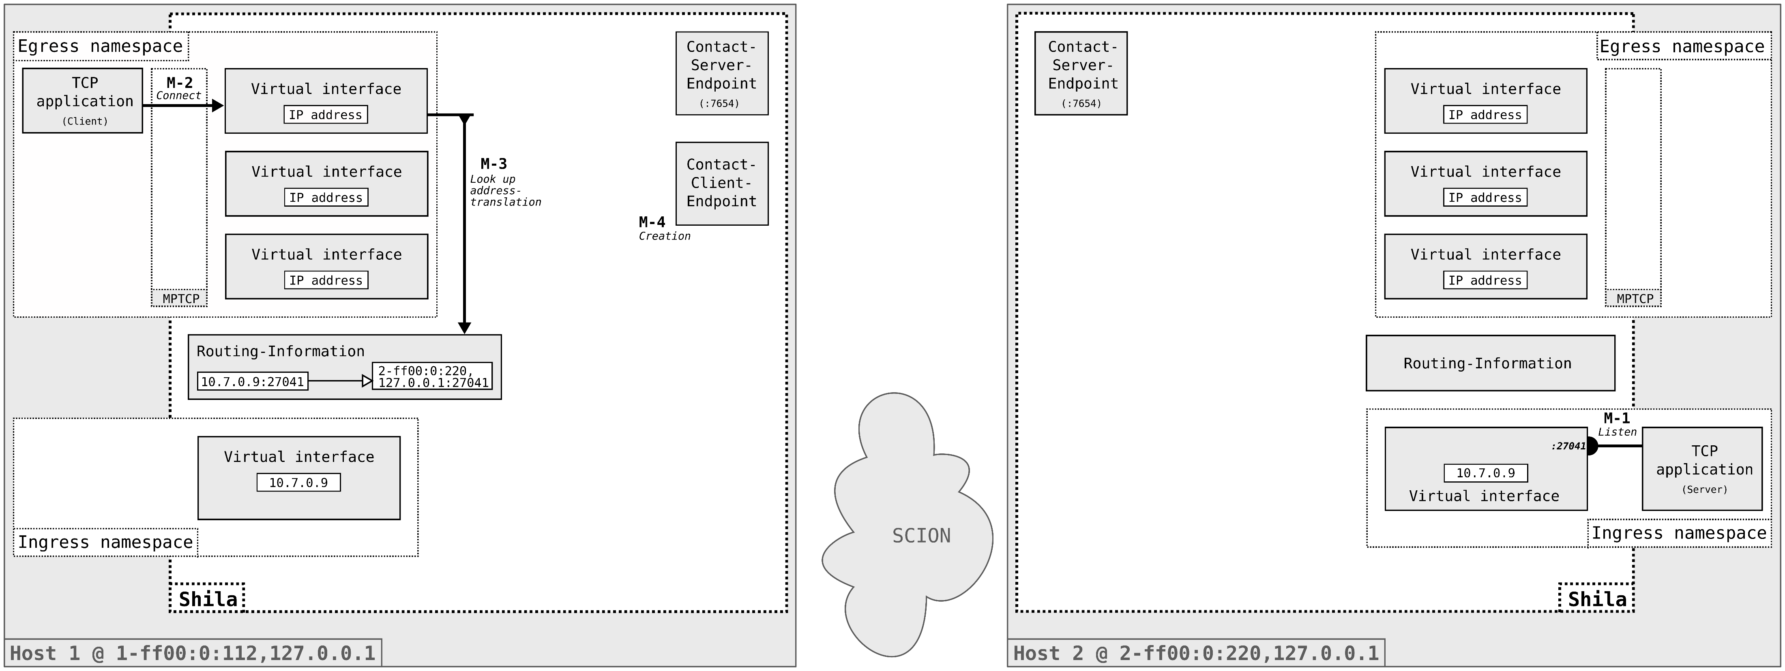
Projektanalyse – Folie 2
Functionality of Shila
Main-Flow Establishment

Slide 23

Projektanalyse – Folie 2
Functionality of Shila
Main-Flow Establishment

Slide 24
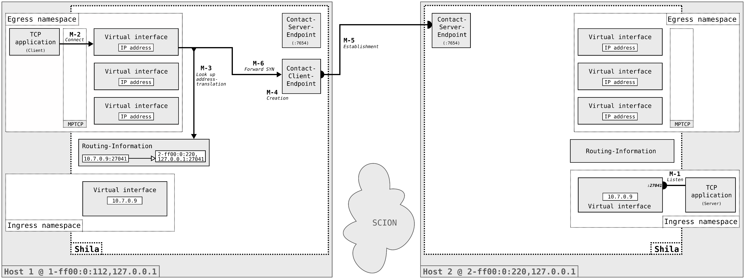
Projektanalyse – Folie 2
Functionality of Shila
Main-Flow Establishment

Slide 25

Projektanalyse – Folie 2
Functionality of Shila
Main-Flow Establishment

Slide 26

Projektanalyse – Folie 2
Functionality of Shila
Main-Flow Establishment

Slide 27
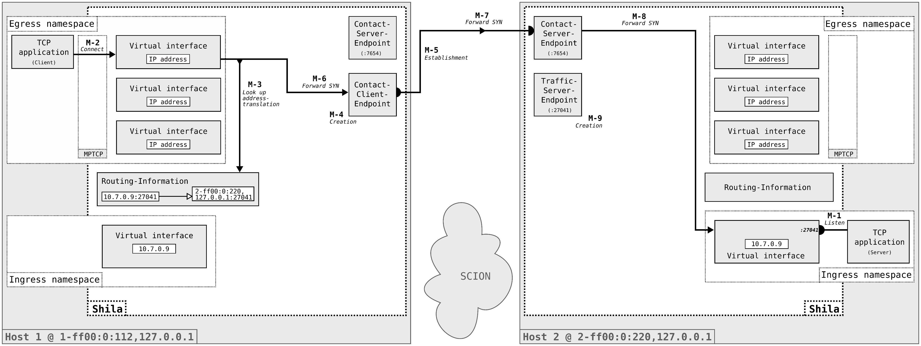
Projektanalyse – Folie 2
Functionality of Shila
Main-Flow Establishment

Slide 28
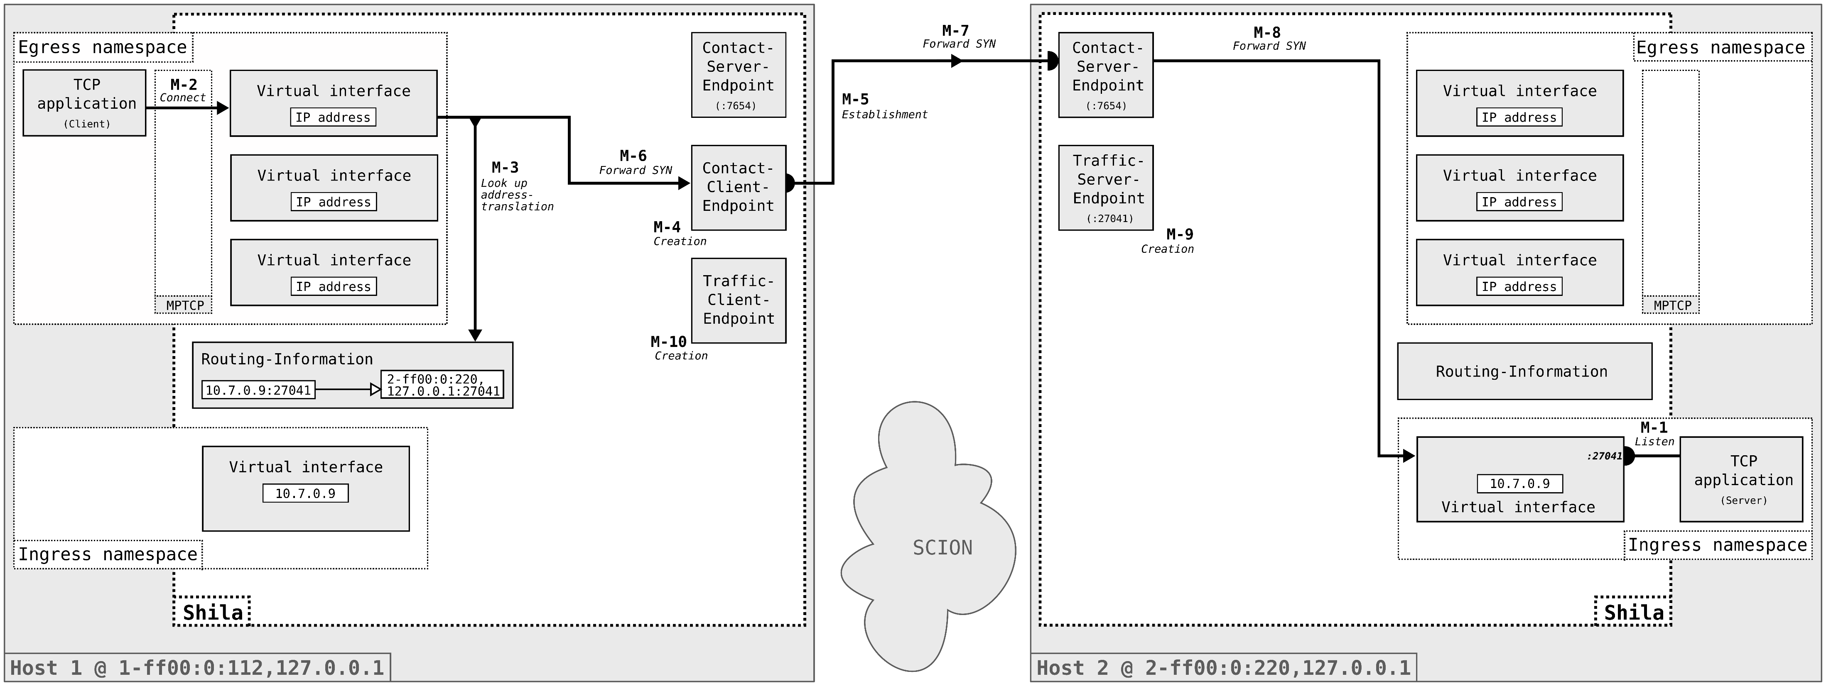
Projektanalyse – Folie 2
Functionality of Shila
Main-Flow Establishment

Slide 29

Projektanalyse – Folie 2
Functionality of Shila
Main-Flow Establishment

Slide 30
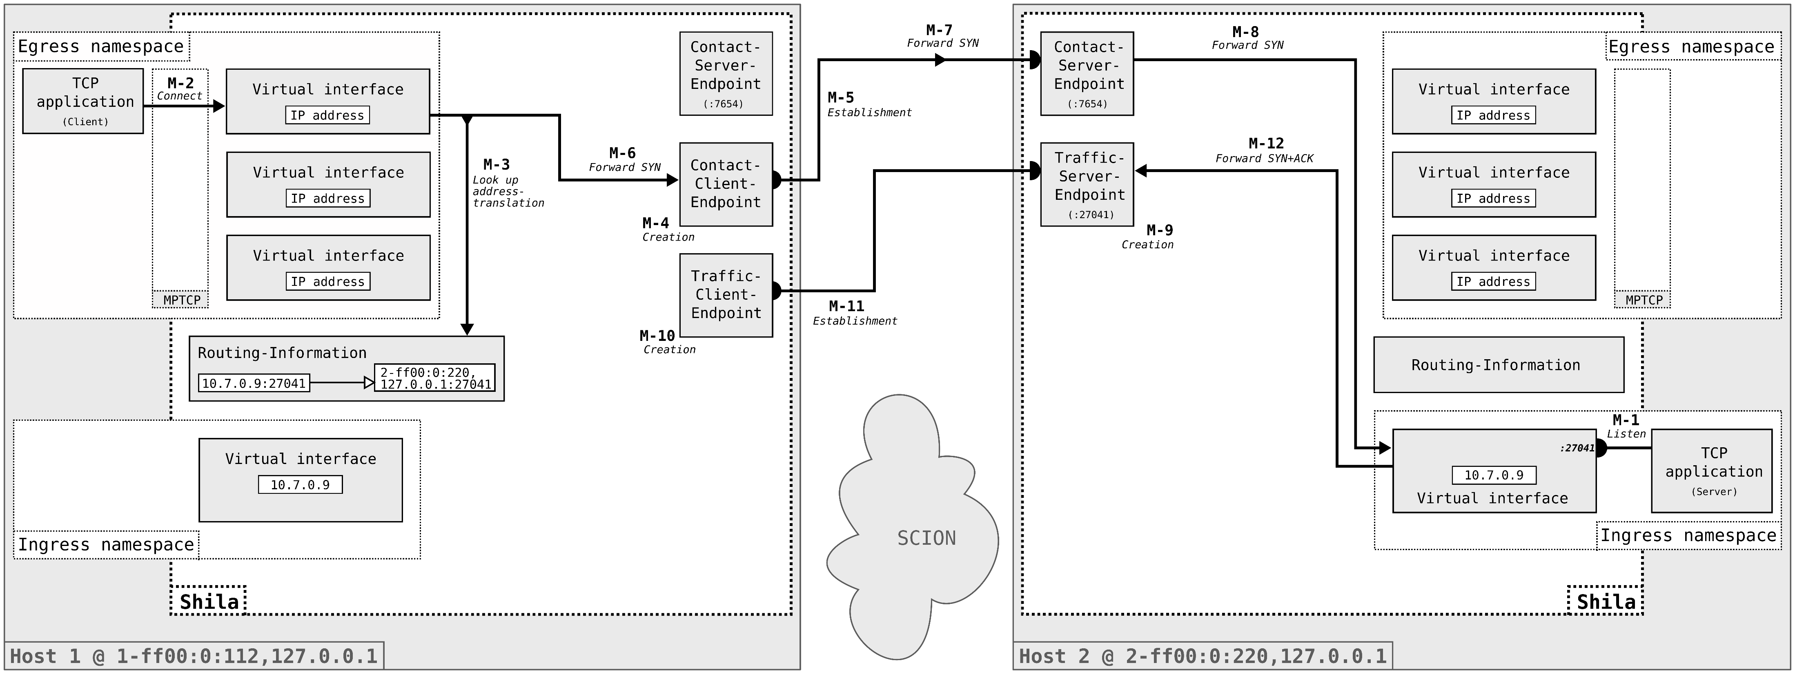
Projektanalyse – Folie 2
Functionality of Shila
Main-Flow Establishment

Slide 31

Projektanalyse – Folie 2
Functionality of Shila
Main-Flow Establishment

Slide 32
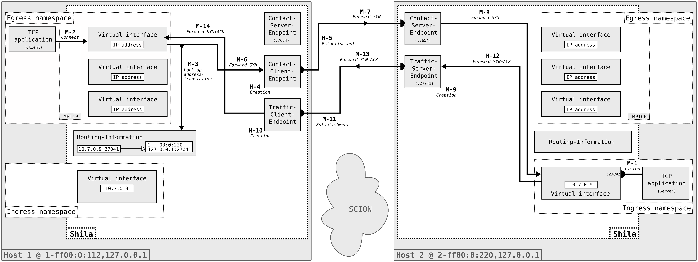
Projektanalyse – Folie 2
Functionality of Shila
Main-Flow Establishment

Slide 33
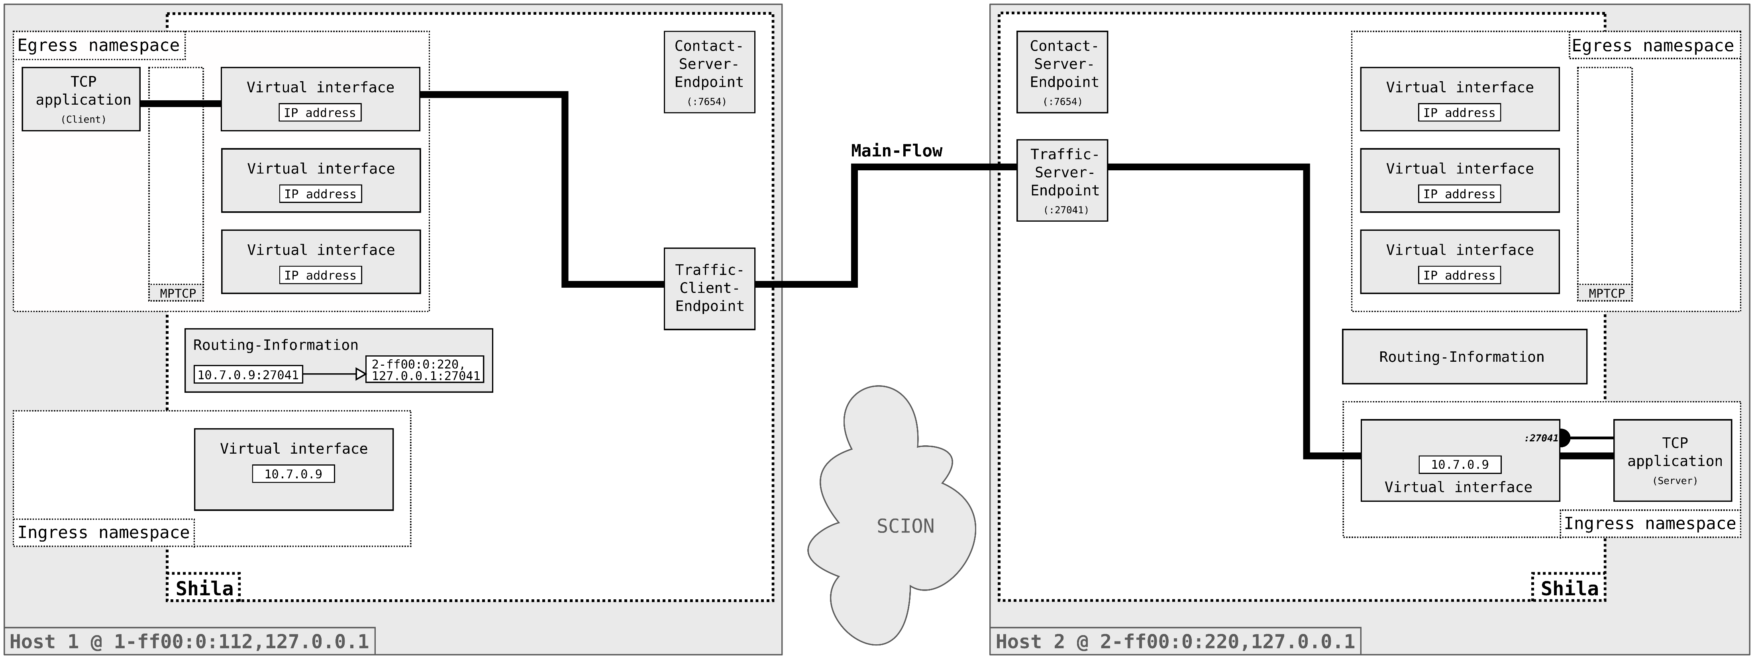
Projektanalyse – Folie 2
Functionality of Shila
Main-Flow Establishment

Slide 34

Projektanalyse – Folie 2
Functionality of Shila
Sub-Flow Establishment

Slide 35
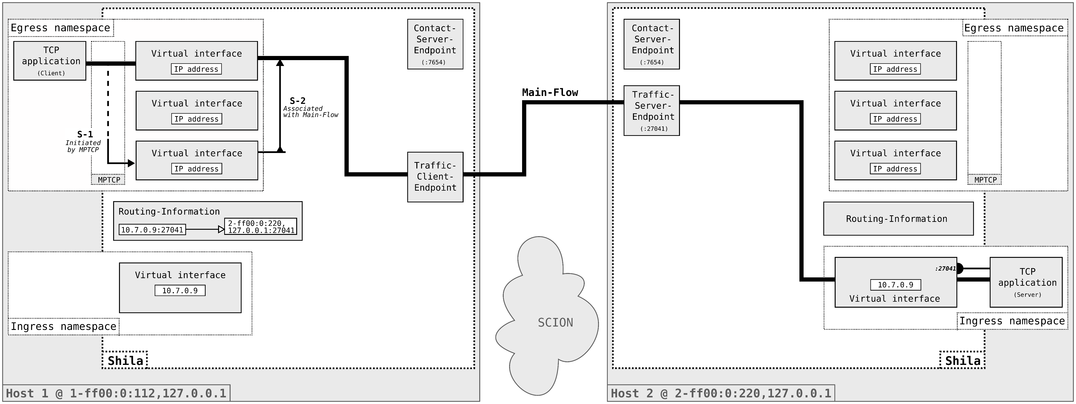
Projektanalyse – Folie 2
Functionality of Shila
Sub-Flow Establishment

Slide 36
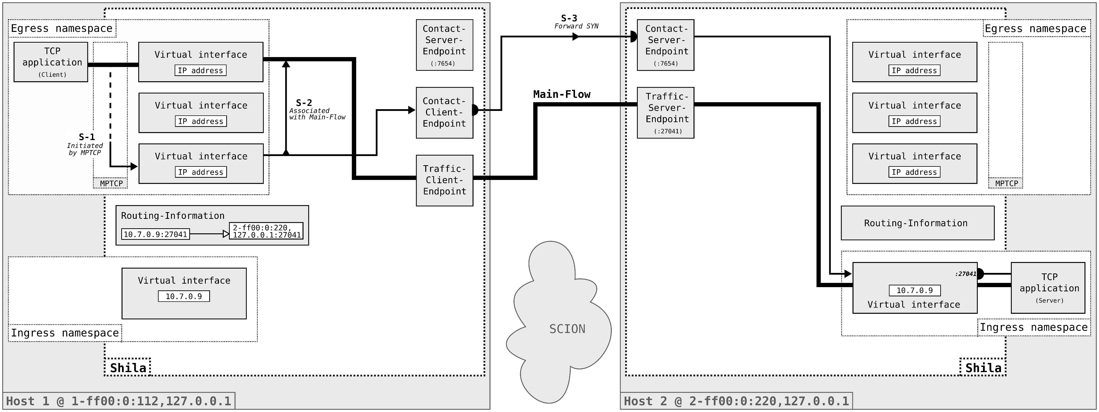
Projektanalyse – Folie 2
Functionality of Shila
Sub-Flow Establishment

Slide 37
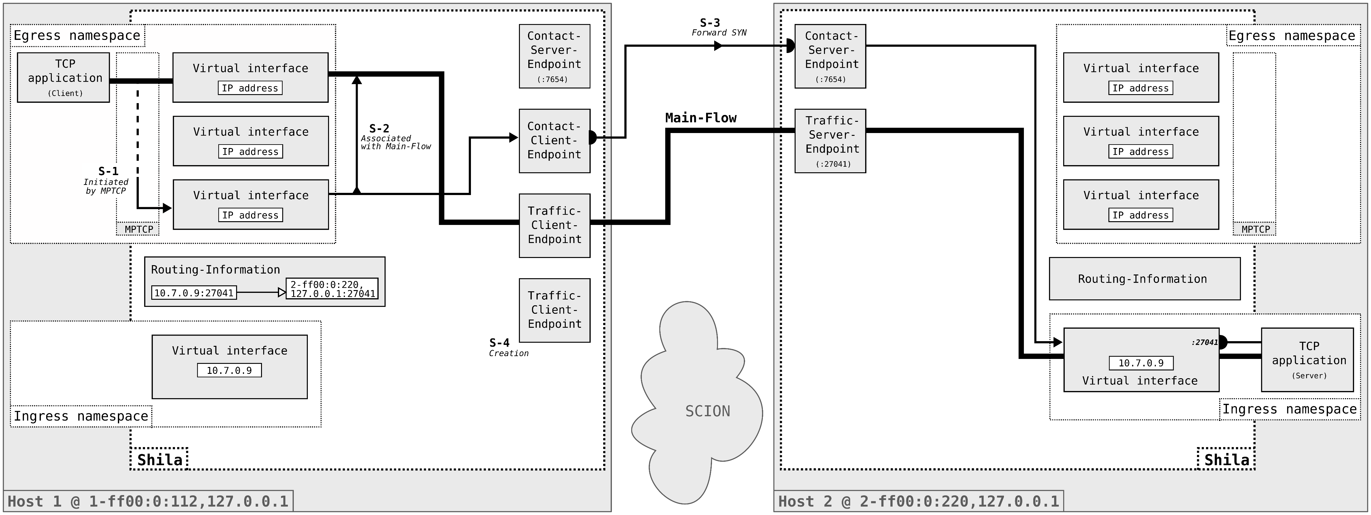
Projektanalyse – Folie 2
Functionality of Shila
Sub-Flow Establishment

Slide 38
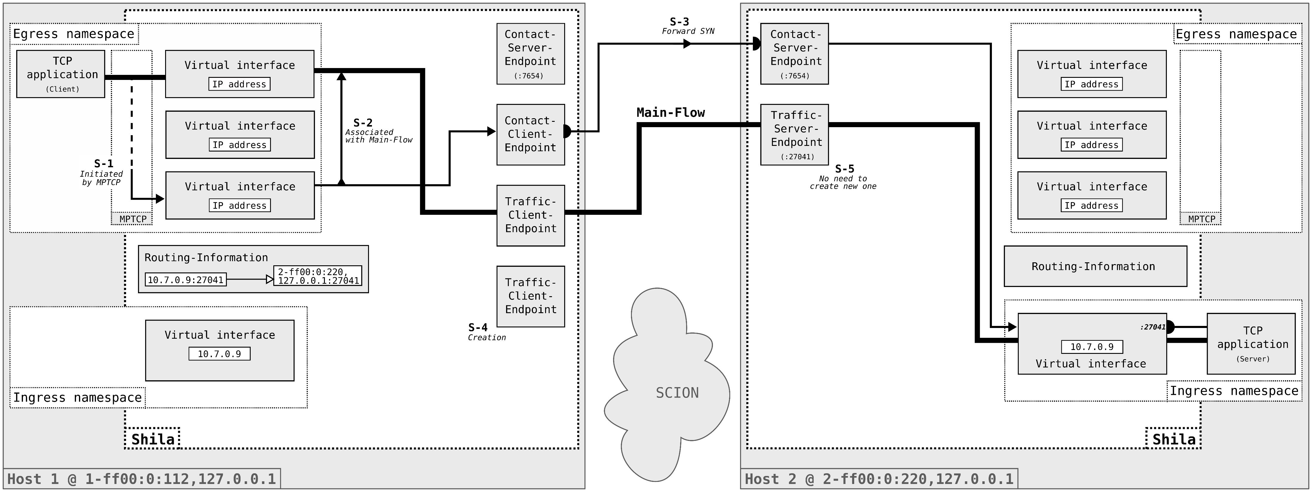
Projektanalyse – Folie 2
Functionality of Shila
Sub-Flow Establishment

Slide 39

Projektanalyse – Folie 2
Functionality of Shila
Sub-Flow Establishment

Slide 40
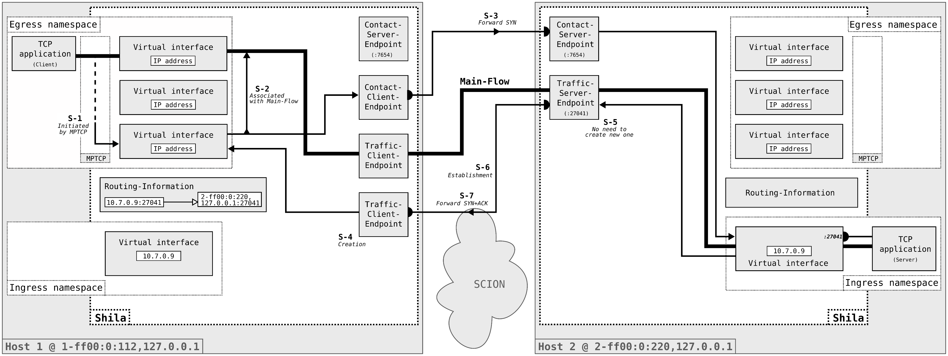
Projektanalyse – Folie 2
Functionality of Shila
Sub-Flow Establishment

Slide 41
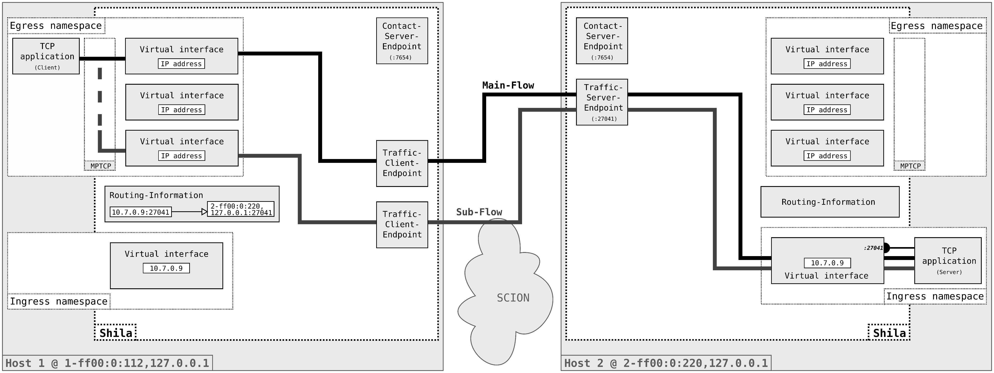
Projektanalyse – Folie 2
Functionality of Shila
Data Exchange

Slide 42
Projektanalyse – Folie 2
On the menu
Introduction
Functionality of Shila
Performance evaluation
Future work

Slide 43


Projektanalyse – Folie 2
Performance evaluation
Questions of interest
How does the performance behave in relation to the
number of paths used for a connection?
How well does Shila compare to QUIC over SCION?

Slide 44
Projektanalyse – Folie 2
Performance evaluation
Setup
Infrastructure
Three custom ASes within the SCIONLab
Shorter inter-European and longer overseas connection
Measure
Goodput with iPerf3 as TCP application
Throughput computed offline from packet capture
Methodology
Data exchange for 30 s between dinstinct ASes
Variation in the number of paths used (1,2,4,6,8)
10 repetitions per fixed set of parameters, random order
Notes:
Want to illustrate this three parts based on an running example..

Slide 45
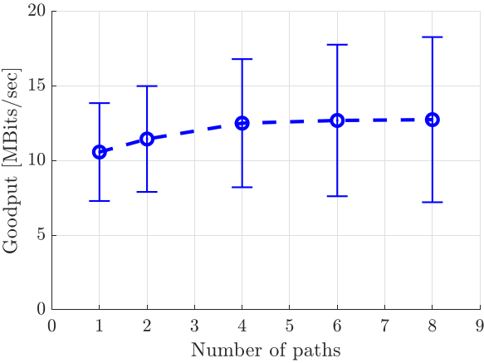
Projektanalyse – Folie 2
Performance evaluation
Result
How does the performance behave in relation to the number of paths used for a connection?
An increase in the number of paths leads to an increase of the average goodput.
Notes:
-> Was what one would expect.
-> In some sort a sanity check
-> High deviation comes from the different performances of the connections (short inter-European vs longer overseas), butshape looks for both the sames

Slide 46
Projektanalyse – Folie 2
Performance evaluation
Result
Paths | Shila |  | QUIC over SCION
 | Goodput | Throughput | Goodput | Throughput
1 | 10.75 ± 3.28 | 17.45 ± 5.91 | 33.31 ± 3.28 | 36.82 ± 3.62
8 | 12.74 ± 5.53 | 19.37 ± 8.36 | - | -
MBits/s
How well does Shila compare to QUIC over SCION?
Shila gets outperformed by QUIC over SCION with respect to goodput as well as overhead.

Slide 47
Projektanalyse – Folie 2
On the menu
Introduction
Functionality of Shila
Performance evaluation
Future work
Notes:
Introduction: What ingredients? What? Why?
Shila: How? (Setup – Connection establishment – Data transfer)
Performance: How good?
Future work: What is next?

Slide 48


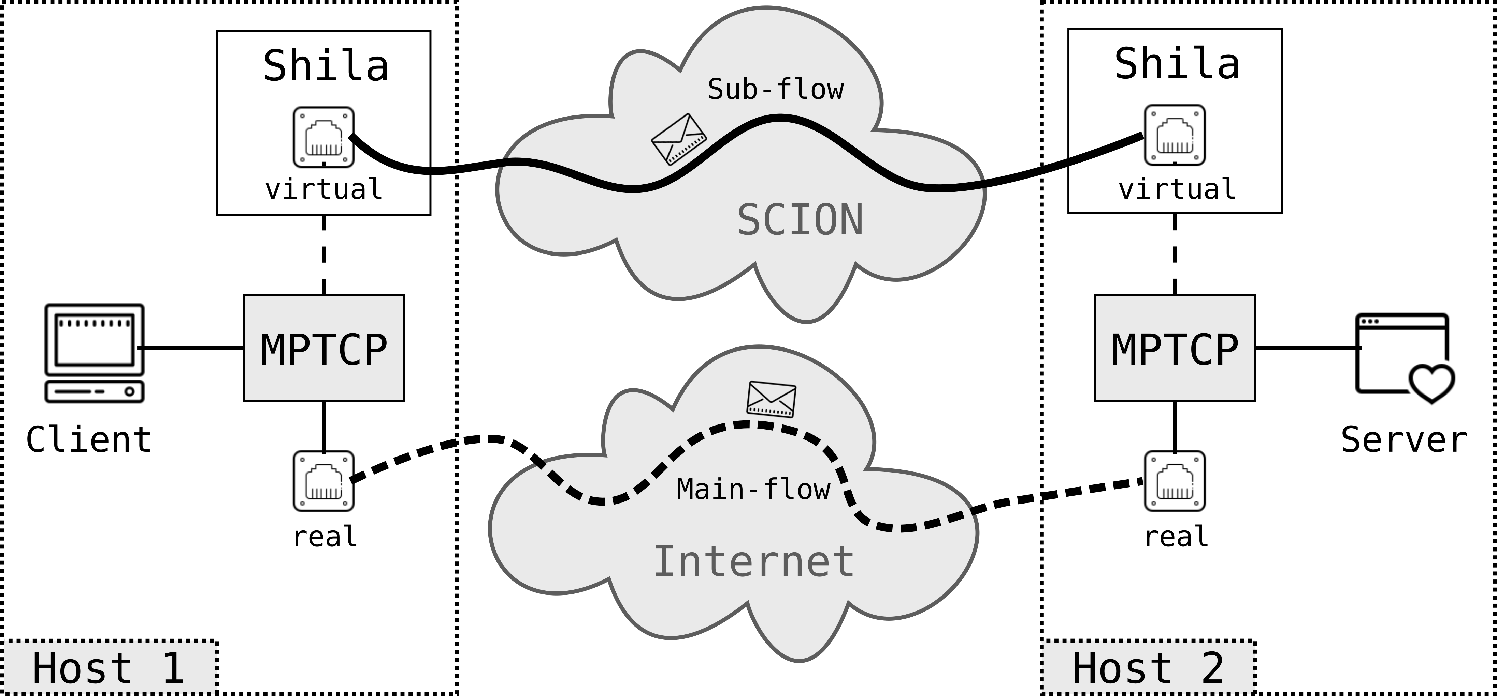

Projektanalyse – Folie 2
Future work
What is next?
Conduction of revision cycles
Improve implementation of Shila
Further testing
Side-by-side approach
Main-flow over conventional Internet
Sub-flow(s) over SCION
Addition of flexibility
Provide mapping betwenn TCP and SCION destination address upon connection establishment
Remove need for namespaces
Notes:
Conduction of revision cycles: For the implementation of Shila, still prototype character, further testing and revision cycles too increase its quality and performance.
Addition of flexibility: In current state, user has to supply mapping upon start-up of Shila, not really practicable, goal to find / implement ways to make this more flexible, one possible approach could for example be to provide the necessary option via IP socket options. Would then require a wrapper around the default TCP API…
Side-by-side approach: Does not interfere with a users known working environment, facilitates the development of SCION, user can just support from the use of it.

Slide 49
Thank you.

Slide 50

Shila as a girls’ name means ”blind”. Shila is a varian form of Sheila (Irish, Gaelic): version of Sile.
STARTS/ENDS WITH Sh-, -la

